Slide 1
Introduction Principles of Programming Language
S.Venkatesan
Reference: Robert W. Sebesta, Concepts of Programming Languages, 10th Edition, Pearson

Slide 2
Why?
Increased Capacity to express Ideas.
Improved Background for choosing appropriate languages.
Increased ability to learn new languages.
Better understanding of the significance of implementation.
Better use of languages that are already known.
Overall advancement of computing.

Slide 3
Programming Domains
Scientific Applications
Business Applications
Artificial Intelligence
System Programming
Web Software

Slide 4
Evaluation Criteria & Characteristic
Criteria
Readability
Writability
Reliability
Characteristic
Simplicity
Orthogonality
Data types
Syntax Design
Support for abstraction
Expressivity
Type Checking
Exception Handling
Restricted aliasing

Slide 5
When evaluating or designing programming languages, various criteria and characteristics are considered to assess their effectiveness, efficiency, and usability. Here is an explanation of each listed criterion and characteristic in the context of programming languages:
### Criteria
#### 1. Readability
Readability refers to how easily a programmer can understand the code written in a language. High readability means the syntax and semantics of the language are designed in such a way that they make the code clear and intuitive. This involves clear naming conventions, a straightforward syntax that mimics natural language to some extent, and the inclusion of comments for documentation.
#### 2. Writability
Writability is about how easily a programmer can write code in a language to solve a problem. This involves the simplicity of the syntax, the availability of high-level constructs (like loops, conditionals, and data structures), and the language's ability to express complex ideas succinctly.
#### 3. Reliability
Reliability in programming languages means that the language provides features to help produce error-free, predictable, and secure code. This includes type checking, exception handling, and features that minimize side effects or undefined behaviors.
### Characteristics
#### 1. Simplicity
A simple programming language has a small set of clear constructs which can be combined to create more complex expressions. Simplicity reduces the learning curve for new developers and minimizes the risk of errors.
#### 2. Orthogonality
Orthogonality in a programming language means that its features can be combined in a small number of ways to build the structure of the program. Each feature should do one thing well and there should be no unexpected interactions between features. This leads to a more predictable and reliable programming model.
#### 3. Data Types
The variety and sophistication of data types a language supports directly impact its expressivity and the ease with which it can model real-world data. Primitive types (like integers, floats, and booleans), structured types (like arrays and records), and abstract data types (like classes in object-oriented programming) are examples.

Slide 6
#### 4. Syntax Design
Syntax design involves the rules and structure for writing statements and expressions in a language. Good syntax design contributes to both readability and writability, making the language intuitive yet powerful enough to express complex logic.
#### 5. Support for Abstraction
Abstraction allows programmers to handle complexity by hiding detailed implementations and exposing only the necessary parts. This includes function abstraction, data abstraction (e.g., classes in OOP), and control abstraction (e.g., loops and conditionals).
#### 6. Expressivity
Expressivity refers to how easily and succinctly a language can express programming constructs and algorithms. Languages that offer high-level constructs (like list comprehensions in Python) allow for more concise code.
#### 7. Type Checking
Type checking is the process of verifying and enforcing the constraints of types. It can be static (at compile time) or dynamic (at runtime). Strong type checking helps catch errors early and improves the reliability of the program.
#### 8. Exception Handling
Exception handling refers to the mechanisms a language provides to deal with unexpected or exceptional runtime conditions. Effective exception handling helps improve a program's reliability and robustness by allowing for graceful recovery from errors.
#### 9. Restricted Aliasing
Aliasing occurs when two or more references point to the same memory location. Restricted aliasing in a language helps in understanding and predicting the effects of code, thereby improving reliability and sometimes performance, as it makes optimization by the compiler easier.
In summary, these criteria and characteristics play a crucial role in the design, selection, and evaluation of programming languages, impacting their success, popularity, and suitability for various types of software development projects.

Slide 7
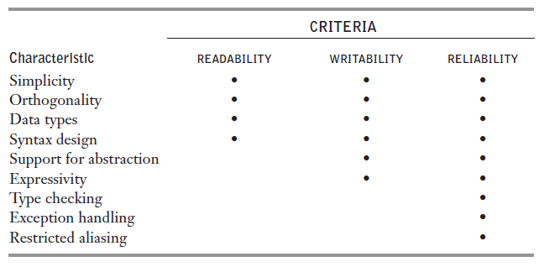
Language evaluation criteria and the characteristics

Slide 8
Readability
Programs that can be read and understood.
Earlier that is before 1970, efficiency was the only point of view.
After 1970, the coding was relegated to a much smaller role and maintenance become a major role. (according to the software life cycle concept by Grady Booch, 1987).
Readability must be considered in the context of the problem domain.

Slide 9
Simplicity
Simplicity affects the readability
Like feature multiplicity
count = count + 1
count += 1
count++
++ count
Operator Overloading

Slide 10
Orthogonality
Independent of the context.

Slide 11
Data Type
Adequate facilities for defining data types and data structures in a language is required.
For example, a numeric type is used for boolean
timeout = 1
However, for language having boolean type we can write
timeout = true

Slide 12
Syntax Design
Special Words
Confusion if reserved words allowed for user defined variable names. For example, fortran – Do and End can be variable.
Compound statements with brace is confusing compare to end if and end loop
Form and Meaning
Semantics or meaning, should follow directly from syntax or form.
Problematic – grep in UNIX

Slide 13
Writability
It is a measure of how easily a language can be used to create programs for a chosen problem domain.

Slide 14
Simplicity and Orthogonality
Large number of constructs might not be familiar with all of them.
Too much orthogonality can be a detriment to writability.
Errors in program can go undetected when nearly any combination of primitives is legal.

Slide 15
Support for Abstraction
Process Abstraction
Use of a subprogram. For example, inserting the sort algorithm in all places as per need.
Otherwise program will be longer or cluttered if we repeat writing it.
Data Abstraction
For example writing a binary tree that stores integer data in its node.
The complexity of writing such program in non-pointer supported languages.

Slide 16
Expressivity
Powerful operations can be accomplished with a complex statements
count++
count = count + 1

Slide 17
Reliability
Type Checking – Compile or Run time
Exception Handling
Aliasing – two or more distinct names that can be used to access the same memory cell.
Readability and Writability - Maintenance

Slide 18
Cost
Training Programmers.
Cost of writing programs.
Cost of Compiling programs – Optimization
Expensive Hardware – can run on it.
Poor reliability – cost of failure in critical system.
Maintenance.
In general – development, maintenance and reliability. Also portability

Slide 19
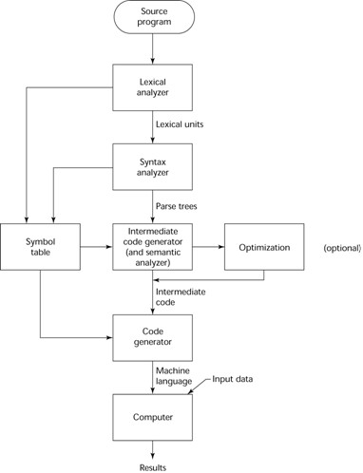
Compiler

Slide 20
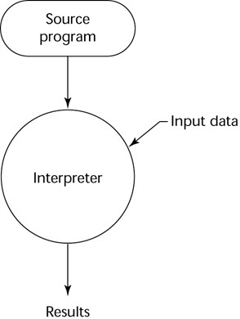
Pure Interpreter

Slide 21
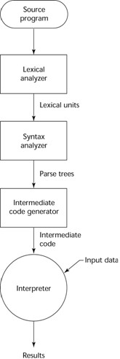
Hybrid Implementation

Slide 22
End of Preliminaries

